Slide 1

Predict App Success using Machine Learning
by
S. Yaswanth Reddy
Roll No. 194G5A0513
T. Shahul
Roll No. 184G1A0585
R. Sai Theja
Roll No. 184G1A0581
S. Supriya
Roll No. 184G1A05a2
Under the guidance of
Mrs. V. Kamakshamma _{M.Tech,(Ph.D)}
Assistant Professor
Department of Computer Science and Engineering
Srinivasa Ramanujan Institute of Technology
(Affiliated to JNTUA & Approved by AICTE) (Accredited by NAAC with ‘A’ Grade & Accredited by NBA (EEE, ECE & CSE)
Rotarypuram Village, B K Samudram Mandal, Ananthapuramu – 515701.
2021 - 2022

Slide 2
Contents
Introduction
Literature Survey
Existing system
Proposed system
Problem Definition
UML Diagram
Data Floe Diagram
Sample Code
Screenshots
Conclusion
References

Slide 3
Introduction
Before launching any new app on google play store, predicting of that app before launching on google play store will helps developers to get better results.
Its important to gather as much data possible to meet the needs and preferences of the user with the help of Dataset that We have.
We collected the Dataset From Kaggle and we Extract some Features from the Original Dataset.
The parameters we have been taken from original Dataset are Category , Size, Type, Price, Content Rating, Genres,

Slide 4
Existing System
As there have been no repository of successful and Unsuccessful applications in the Android operating system.
There was no attention for low rated apps as they deserve more attention because of new app in that category were to put on Google Play Store.
Disadvantages:
Accuracy low
Operating cost is high
3. Difficult to handle

Slide 5
Proposed System
We proposed a structure that offers a mobile application developers a more detailed and informative view of the success prediction made by evaluating the Dataset.
This structure helps the Developers to predict new apps success .
Our proposed concept will facilitate the developers to assume whether they are proceeding in right way or not by analyzing the information they got.
Advantages:
1. Accuracy is maximum
2. Prediction is accurate

Slide 6
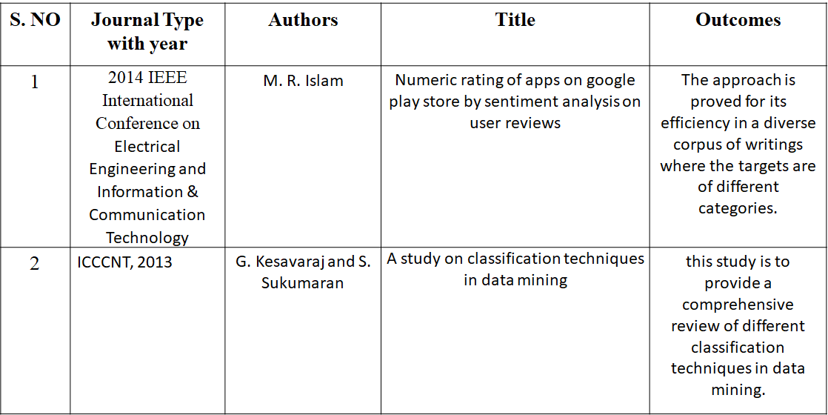
Literature Survey

Slide 7
S. NO | Journal Type with year | Authors | Title | Outcomes
3 | ACM, 2009 | X. Amatriain, J. M. Pujol, N. Tintarev, and N. Oliver | Rate it again: increasing recommendation accuracy by user re-rating | we propose a method to determine whether the ratings from users are consistent to their own preferences (represented as a set of dominant attribute values) or not and eventually to correct these ratings to improve recommendation.
4 | Cloud Computing and Services Science, 2014 | S. Nishida and Y. Shinkawa | Data Integrity in Cloud Transactions | This paper presents a formal, simulationbased, and model driven approach to evaluating data integrity in BASE transaction systems.

Slide 8
Problem definition
An Appstore contains all the apps that are present in the market . For example if any of the developers planning to introduce some new apps of their own .
First they want to find out what would be the popularity of the new apps in the market based on other apps.
The usage of apps is different from one user to another and installation is also differs from one user to another user.
The task is to identify the categories of applications which user finds more fascinating to use .
And also identify which users are most likely not to install or avoid the selected apps.

Slide 9
Requirements
Python v3.6+
PyCharm IDE.
RAM: 4GB minimum.
Processor: Intel I3 (min)
Hard Disk: 128 GB +
OS: Windows 7+

Slide 11
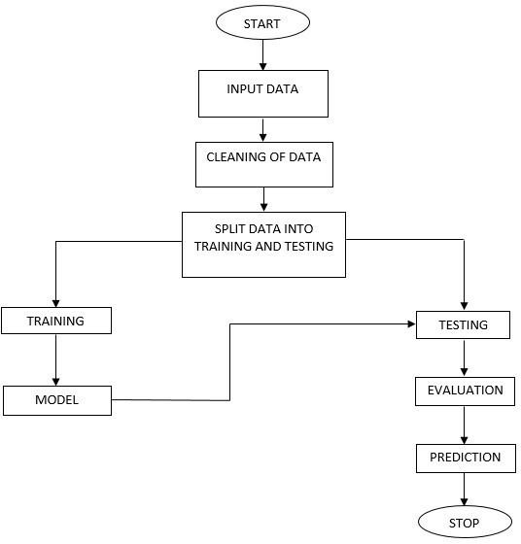
Design
Flow Of The Project

Slide 12
Implementation I
System:
Takes Data
Stores Data
Model Training
Model Predictions
User:
Load Dataset
View Dataset.
Select Model.
Predictions

Slide 13
Contd…
User
Upload:
Upload dataset which is downloaded from the Kaggle
View Data:
View data after pre-processing (cleaned dataset)
Input:
User will give the input values of app, category, rating, reviews, size, installs, type, price, content rating, genres, last updated and current ver these parameters and user can select the algorithm.

Slide 14
Contd..
Result History:
After giving the inputs, model will predict the result which it was set according to performance, it will predict that the google play store are Not.
Take Dataset:
The dataset for the cleaned is collected from the Kaggle website (kaggle.com).
The Data set columns app, category, rating, reviews, size, installs, type, price, content rating, genres, last updated, current version and android version.

Slide 15
Contd..
Pre-processing:
In pre-processing first of all we will check whether there is any Nan values.
If any Nan values is present, we will fill the Nan values with different fillna() method used to replaces the null values.
Here we used the ffill (forward fill) technique on our project.
Training the data:
Irrespective of the algorithm we select the training is the same for every algorithm.
Given a dataset we split the data into two parts training and testing, the reason behind doing this is to test our model/algorithm performance just like the exams for a student ,the testing is also exam for the model.

Slide 16
Contd..
We can split data into anything we want but it is just good practice to split the data such that the training has more data than the testing data, we generally split the data into 70% training and 30% testing.

Slide 17
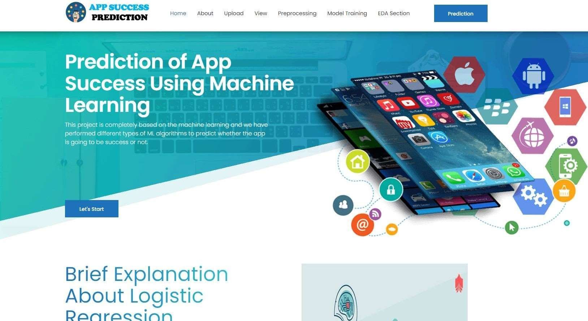
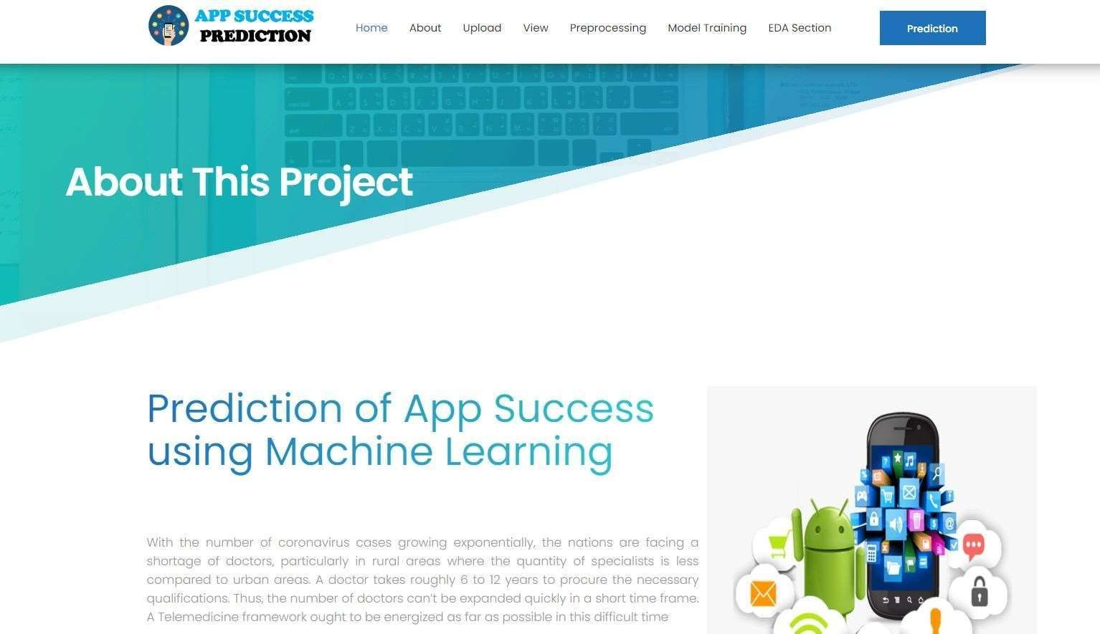
Execution
Home Page
About Page

Slide 18
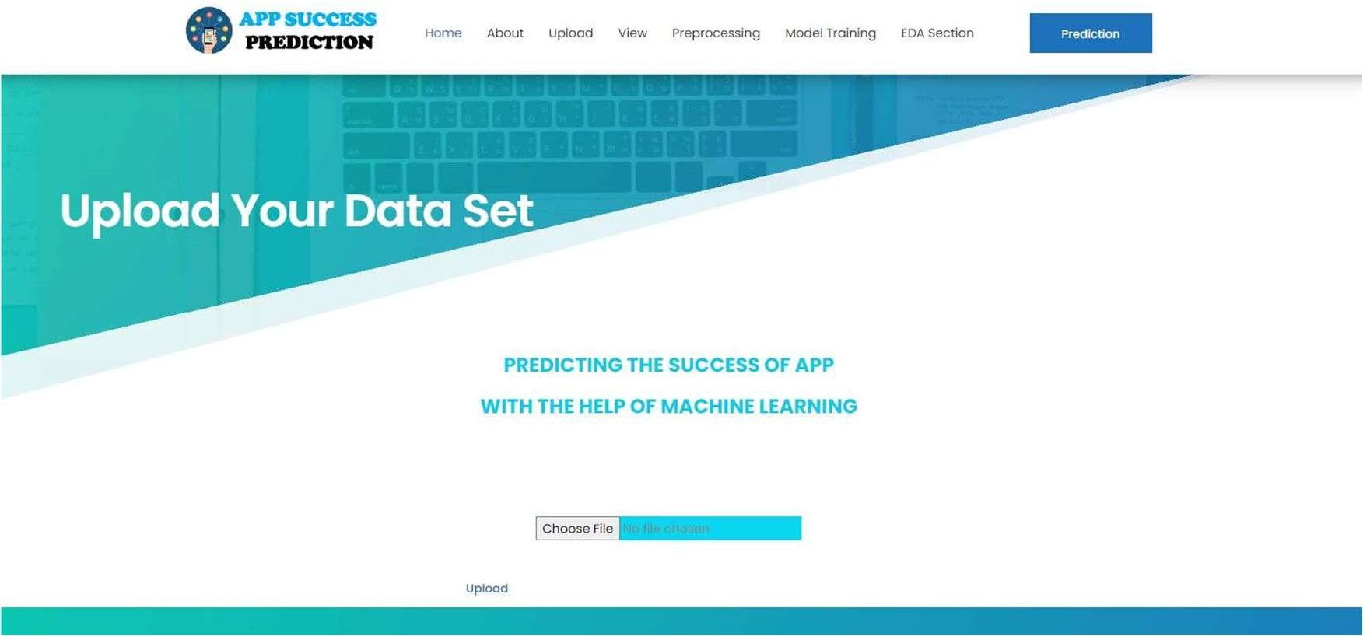
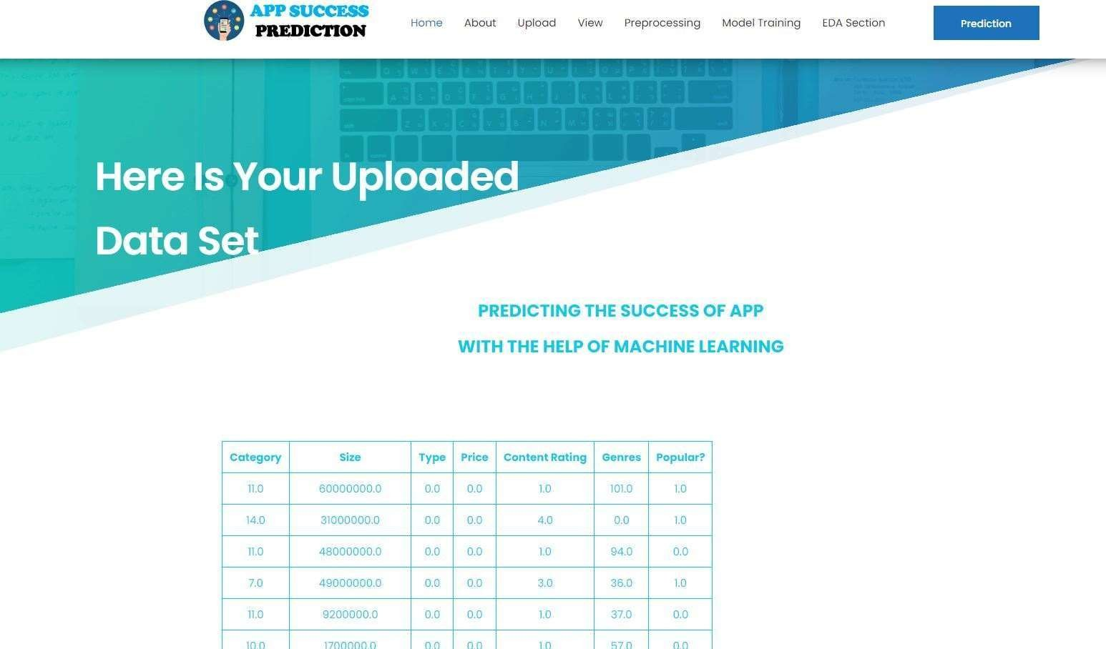
Contd..
Upload Page
View Data

Slide 19
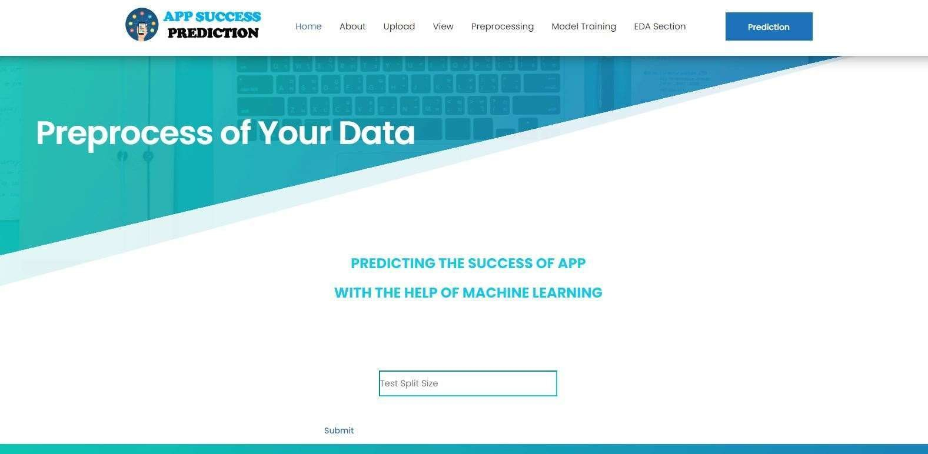
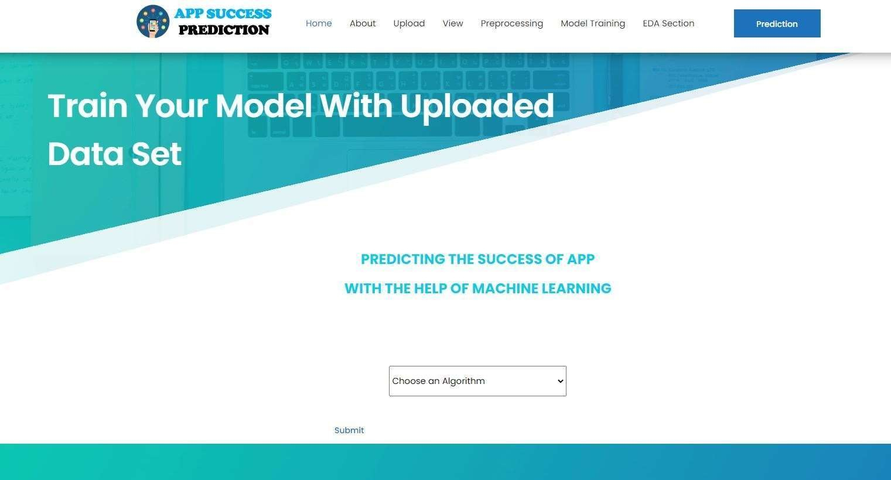
Contd..
Preprocessing
Model Training

Slide 20
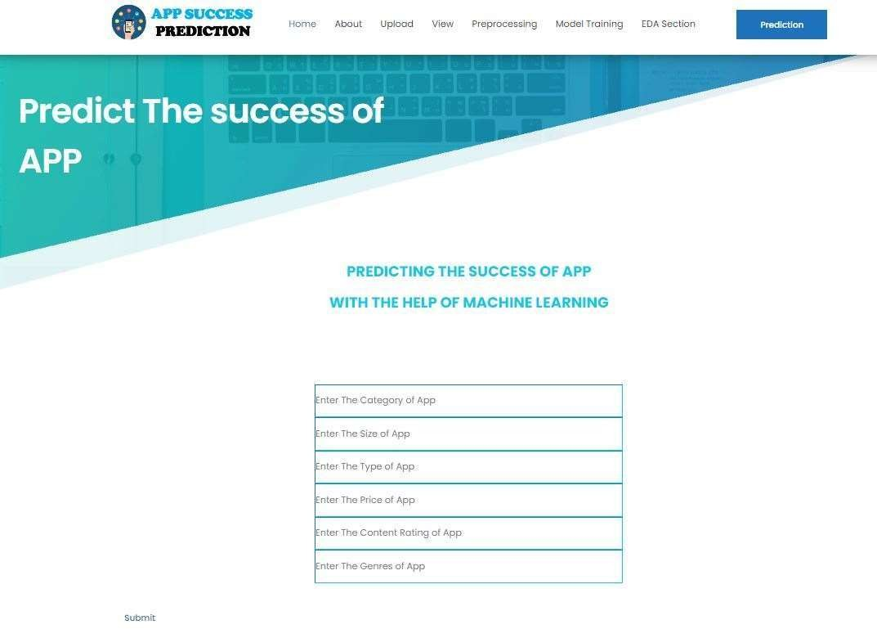
Contd…
Prediction

Slide 21
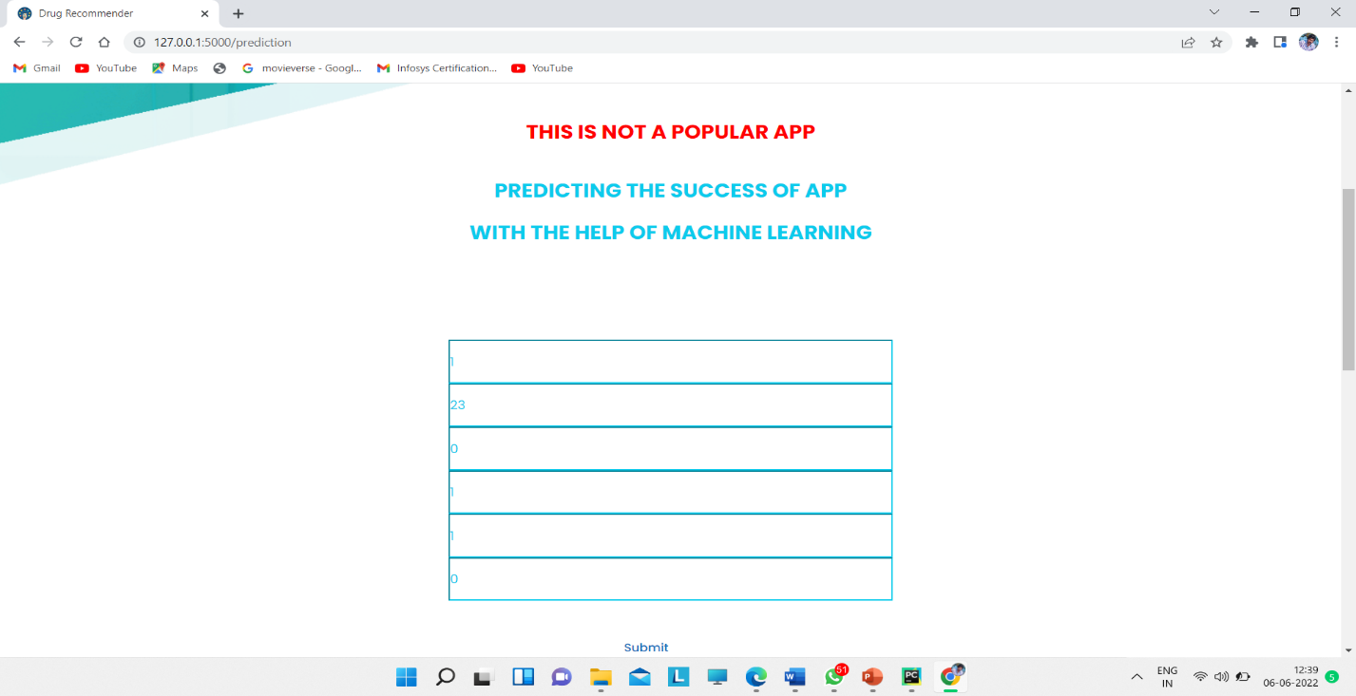
Result

Slide 22
Conclusion
The project has concluded that, to know the success or failure status of the application we used the machine learning based method such as Decision Tree classification techniques to get better accuracy. The algorithm works on success rate of application and it will gives the results whether the application is successful or fail.

Slide 23
Reference
[1]. Habib Seifzadeh1,2 · Ghassan Beydoun3 · Mohammad H. Nadimi-Shahraki, “Title of_{f} the paper”,” Mie M, Thwin T, Tong-Seng Q (2016) Application of neural network for predicting software development faults using object oriented design metrics. In: Proceedings of the 9th International Conference on Neural Information Processing, vol 5, pp 2312– 2316.
[2]. https://www.semanticscholar.org/paper/Prediction-for-Mobile-Application-Usage-Patterns-Tan-Liu/75efc27d5c6ed6fc8c9310d512151db2fc4f4679
[3]. https://www.jstage.jst.go.jp/article/ipsjjip/29/0/29_597/_pdf

Slide 24
Thank You!!!

